Slide 1
ING 112A SPRING 2022 Week 5 CITATION WITHIN CITATION PARAPHRASE
ASLI ÖZKARA
ITU, ADVANCED ENGLISH PROGRAM

Slide 2
What did we learn last week?
What is a paraphrase?
How do we paraphrase a sentence?

Slide 3
1. Choose the correct citation options?
Source: Microsoft teams usage jumps. T. Warren, April 2020
……………….. (Warren, 2020).
……………….. (T. Warren, 2020).
………………… (Microsoft teams usage jumps, Warren, 2020).
Warren indicates that ……………….. (2020).
Warren indicates that ……………….. (Microsoft teams usage jumps, 2020).
As Warren indicates in the article “Microsoft Teams Usage Jumps” ……………….. (2020).
As Warren indicates in the article “Microsoft teams usage jumps” ……………….. (2020).
As Warren indicates in the article Microsoft Teams Usage Jumps, ……………….. (2020).

Slide 4
1. Choose the correct citation options?
Source: Microsoft teams usage jumps. T. Warren, April 2020
……………….. (Warren, 2020). ✔ We write only the surname.
……………….. (T. Warren, 2020).
………………… (Microsoft teams usage jumps, Warren, 2020).
Warren indicates that ……………….. (2020). ✔ We don’t write the article title in parentheses when we know the author surname.
Warren indicates that ……………….. (Microsoft teams usage jumps, 2020).
As Warren indicates in the article “Microsoft Teams Usage Jumps”, ……………….. (2020). ✔ We can optionally add the article title in quotation marks, but we must capitalize each word.
As Warren indicates in the article “Microsoft teams usage jumps”, ……………….. (2020).
As Warren indicates in the article Microsoft Teams Usage Jumps, ……………….. (2020).

Slide 5
2. Choose the correct citation options?
Source: Video chat apps. World Economic Forum, May 2020
……………….. (World Economic Forum, 2020).
……………….. (Video chat apps, World Economic Forum, 2020).
World Economic Forum reports that ……………….. (Video chat apps, 2020).
World Economic Forum reports that ……………….. (2020).
According to the article “Video chat apps” by World Economic Forum, ………………….. (2020).
According to the article Video Chat Apps by World Economic Forum, ………………….. (2020).
According to the article “Video Chat Apps” by World Economic Forum, ………………….. (2020).

Slide 6
2. Choose the correct citation options?
Source: Video chat apps. World Economic Forum, May 2020
……………….. (World Economic Forum, 2020). ✔If there is no author, we only write the organization name in the parentheses.
……………….. (Video chat apps, World Economic Forum, 2020).
World Economic Forum reports that ……………….. (Video chat apps, 2020).
World Economic Forum reports that ……………….. (2020). ✔ If we know the organization name, we don’t write the article title in parentheses.
According to the article “Video chat apps” by World Economic Forum, ………………….. (2020).
According to the article Video Chat Apps by World Economic Forum, ………………….. (2020).
According to the article “Video Chat Apps” by World Economic Forum, ………………….. (2020). ✔ We can optionally add the article title in quotation marks, but we must capitalize each word.

Slide 7
3. Choose the correct citation options?
Source: COVID-19 impact on cloud computing market. 2020
……………….. (COVID-19 impact on cloud computing market, 2020).
……………….. (“COVID-19 impact on cloud computing market”, 2020).
……………….. (“COVID-19 Impact on Cloud Computing Market”, 2020).
According to the article COVID-19 impact on cloud computing market, ………………….. (2020).
According to the article “COVID-19 impact on cloud computing market”, ………………….. (2020).
According to the article “COVID-19 Impact on Cloud Computing Market”, ………………….. (2020).

Slide 8
3. Choose the correct citation options?
Source: COVID-19 impact on cloud computing market. 2020
……………….. (COVID-19 impact on cloud computing market, 2020).
……………….. (“COVID-19 impact on cloud computing market”, 2020).
……………….. (“COVID-19 Impact on Cloud Computing Market”, 2020). ✔ If there is no author or organization, we can write the article title in parentheses, and it must be in quotation marks and each word must be capitalized.
According to the article COVID-19 impact on cloud computing market, ………………….. (2020).
According to the article “COVID-19 impact on cloud computing market”, ………………….. (2020).
According to the article “COVID-19 Impact on Cloud Computing Market”, ………………….. (2020). ✔

Slide 9

4. Choose the correct paraphrase option?
The international affect of COVID-19 is predicted to grow from USD 233 billion in 2019 to USD 295 billion by means of 2021
Source: COVID-19 impact on cloud computing market. 2020
The global impact of COVID-19 on cloud market size is expected to grow from USD 233 billion in 2019 to USD 295 billion by 2021. Major factors driving the growth of the market include enterprises’ need to support remote workforce to induce investment in IT infrastructure for hyperscalers, cloud service providers (CSPs), internet service providers (ISPs), and managed hosting providers.
As stated in the article “COVID-19 Impact on Cloud Computing Market”, …
the worldwide effect of COVID-19 on cloud market size is relied upon to develop from USD 233 billion of every 2019 to USD 295 billion by 2021 (220).
the worldwide affect of COVID-19 on cloud market size is anticipated to develop from USD 233 billion in 2019 to USD 295 billion by 2021 (2020).
the global impact of COVID-19 on cloud market size is predicted to develop from USD 233 billion in 2019 to USD 295 billion via way of means of 2021 (2020).
the international effect of COVID-19 on cloud market size is predicted to grow from USD 233 billion in 2019 to USD 295 billion by means of 2021 (2020).

Slide 10
4. Choose the correct paraphrase option?
Source: COVID-19 impact on cloud computing market. 2020
The global impact of COVID-19 on cloud market size is expected to grow from USD 233 billion in 2019 to USD 295 billion by 2021. Major factors driving the growth of the market include enterprises’ need to support remote workforce to induce investment in IT infrastructure for hyperscalers, cloud service providers (CSPs), internet service providers (ISPs), and managed hosting providers.
As stated in the article “COVID-19 Impact on Cloud Computing Market”,
the worldwide effect of COVID-19 on cloud market size is relied upon to develop from USD 233 billion of every 2019 to USD 295 billion by 2021 (2020). ❌
the worldwide affect of COVID-19 on cloud market size is anticipated to develop from USD 233 billion in 2019 to USD 295 billion by 2021 (2020). ❌
the global impact of COVID-19 on cloud market size is predicted to develop from USD 233 billion in 2019 to USD 295 billion via way of means of 2021 (2020). ❌
the international effect of COVID-19 on cloud market size is predicted to grow from USD 233 billion in 2019 to USD 295 billion by means of 2021 (2020). ❌

Slide 11
4. Choose the correct paraphrase option?
Source: COVID-19 impact on cloud computing market. 2020
The global impact of COVID-19 on cloud market size is expected to grow from USD 233 billion in 2019 to USD 295 billion by 2021. Major factors driving the growth of the market include enterprises’ need to support remote workforce to induce investment in IT infrastructure for hyperscalers, cloud service providers (CSPs), internet service providers (ISPs), and managed hosting providers.
As stated in the article “COVID-19 Impact on Cloud Computing Market”, the estimations for the growth will be 62 billion US dollars in one year period. The market size was 233 billion in 2019, but the projection is 295 billion by 2021 (2020).

Slide 12
5. Choose the correct paraphrase option?
Source: Ikea's online sales surged as people turned homes into offices and schools. H. Ziady, October 2020
Ikea's online sales got a big boost during the pandemic as millions of people turned their homes into makeshift schools and offices. The company said that online sales surged 45% over the 12 months to August, driven by 4 billion visits to its website. Outdoor furniture was the retailer's fastest-growing category, with sales of office furniture also performing strongly.
Ikea reported a 45% increase in their sales in the 12-month-period until August, and the number of people who visited their website reached 4 billion (Ziady, 2020).
Ziady states that the company told that online purchases increased 45 percent in 12 months up to August, with 4 billion visits to the website.
The organization said that online deals flooded 45% over a year to August, driven by 4 billion visits to its site (Ziady, 2020).

Slide 13
5. Choose the correct paraphrase option?
Source: Ikea's online sales surged as people turned homes into offices and schools. H. Ziady, October 2020
Ikea's online sales got a big boost during the pandemic as millions of people turned their homes into makeshift schools and offices. The company said that online sales surged 45% over the 12 months to August, driven by 4 billion visits to its website. Outdoor furniture was the retailer's fastest-growing category, with sales of office furniture also performing strongly.
Ikea reported a 45% increase in their sales in the 12-month-period until August, and the number of people who visited their website reached 4 billion (Ziady, 2020). ✔
Ziady states that the company told that online purchases increased 45 percent in 12 months up to August, with 4 billion visits to the website (2020).
The organization said that online deals flooded 45% over a year to August, driven by 4 billion visitors to its site (Ziady, 2020).

Slide 14
What are we going to learn today?
What’s citation-within-citation?
What’s a summary paraphrase?

Slide 15
CITATION WITHIN CITATION Book p. 30
When you borrow information cited in another text, you have to cite both of them:
Richard Baldwin, 2020
…………………………………………………….
Published studies of the causes of the Great Trade Collapse provide important hints about what may unfold going forwards. There were three leading hypotheses for what may have caused the collapse as follows: (1) a decline in aggregate demand for all goods, including imports; (2) difficulties in obtaining trade finance; and (3) rising trade barriers (Crowley & Luo, 2011).
The received wisdom is that the collapse was due mostly to the demand shock – especially for ‘postpone-able’ goods (Bénassy-Quéré et al., 2009). That is, since a large fraction of trade is in durable goods, exports tend to be two to three more times volatile than GDP (Engel, 2011).
…………………………………………………………
The source you have found: Baldwin, 2020, p. 5
The source that has been cited by the one you have found: Engel, 2011
As cited by Baldwin, Engel indicates that the trade of durable goods comprise a high percentage, thus the unexpected changes in exports are two or three times more than GDP (2020, p. 5).
Engel (cited in Baldwin, 2020) indicates that the trade of durable goods comprise a high percentage, thus the unexpected changes in exports are two or three times more than GDP (p. 5).

Slide 16
What is a summary paraphrase?
It is shortening and restating the original text by selecting the relevant information.
It is significantly shorter than the original text.

Slide 17
Steps of summarising:
Make sure that you understand the original text correctly.
Highlight/Underline relevant information from the source.
Write the highlighted/underlined parts in your own words.
Do not add your comment.
Do not change the meaning.
Remember to cite correctly.

Slide 18
1. We might need to paraphrase the main points of a text
2. We might need to paraphrase a specific example from a text
3. We might need to paraphrase a study explained in a text.

Slide 19

1. We might need to paraphrase the main points of a text

Slide 20
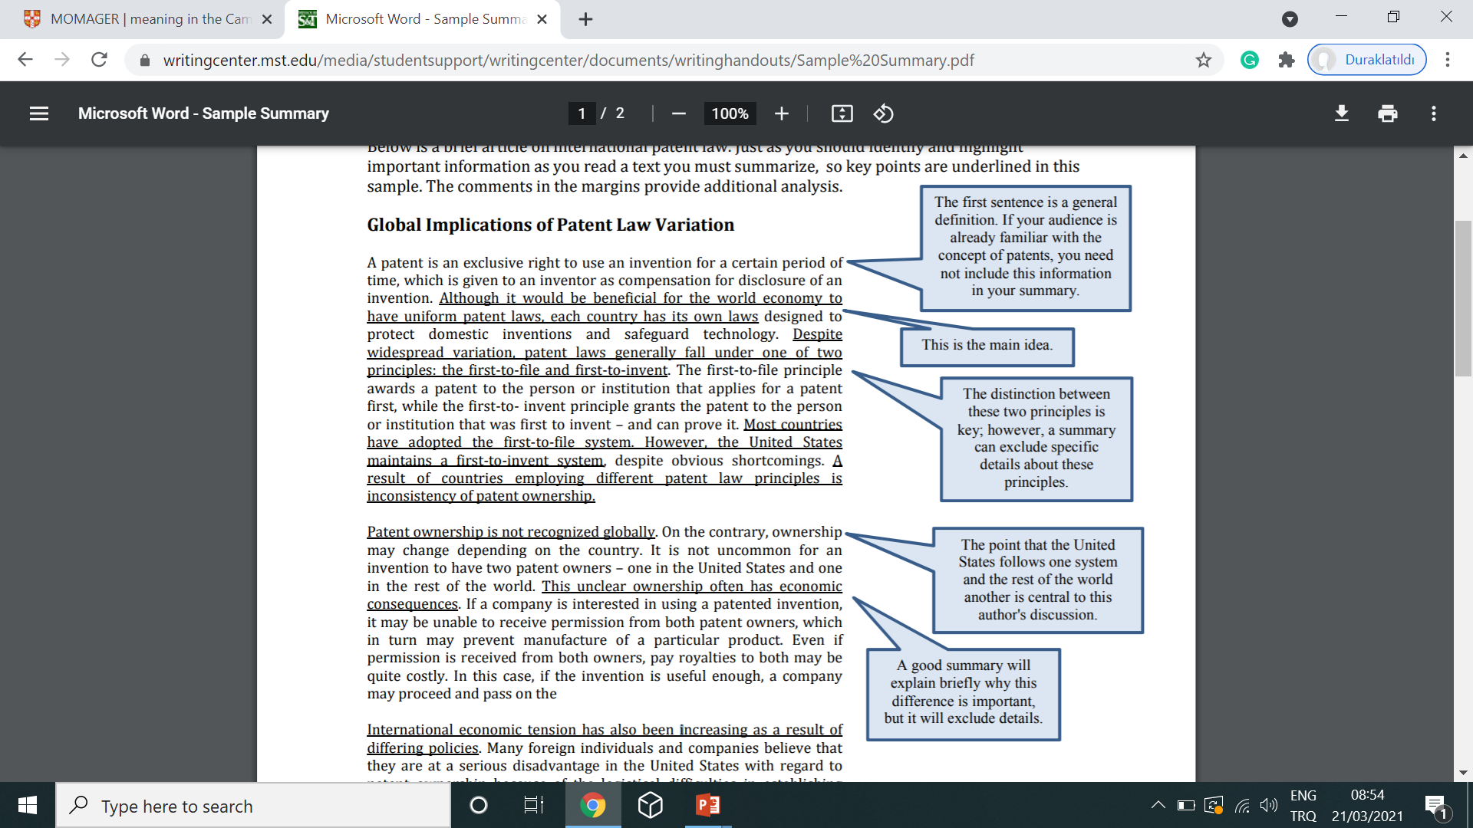
Taken and adapted from www.writingcenter.mst.edu

Slide 21
This is the paraphrase of the underlined parts:
Source: Tory Suzuki, 1991
………………………… In his paper “Global Implications of Patent Law Variation,” Suzuki notes that lack of consistency in the world's patent laws is a serious problem. Most nations give patent ownership to the inventor who first files for a patent. However, the United States grants patents to the inventor. These variations in patent laws can cause economic problems (1991). ………………………

Slide 22
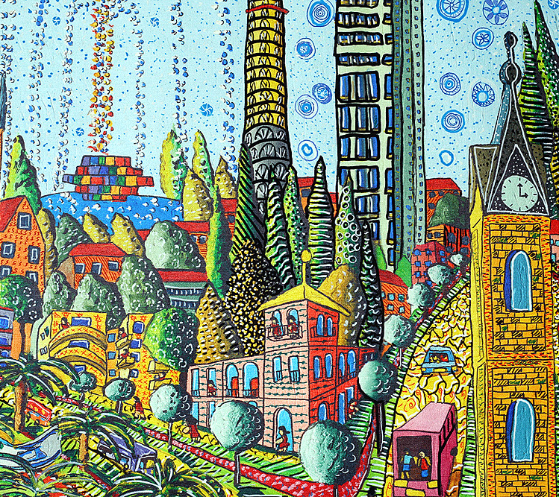
2. We might need to paraphrase a specific example from a text

Slide 23
Book p. 45, ex. 8
Hydraulics developed as a purely empirical science with practical techniques beginning in prehistoric times. As our ancestors settled to engage in farming and their hamlets developed into villages, the continuous supply of a proper quantity of water and the transport of essential food and materials posed the most important problems. In this sense, it is believed that hydraulics was born in the utilization of water channels and ships. Prehistoric relics of irrigation canals were discovered in Egypt and Mesopotamia, and it has been confirmed that canals had been constructed more than 4000 years BC. Water in cities is said to have begun in Jerusalem, where a reservoir to store water and a masonry channel to guide the water were constructed. Water canals were also constructed in Greece and other places. Above all, however, it was the Romans who constructed channels throughout the Roman Empire. Even today their remains are still visible in many places in Europe. As stated above, the history of the city water system is very old. But in the development process of city water systems, in order to transport water effectively, the shape and size of the water conduit had to be designed and its inclination or supply pressure had to be adjusted to overcome friction with the wall of the conduit. This gave rise to much invention and progress in overcoming hydraulic problems.

Slide 24
This is the paraphrase of the highlighted part:
Water has played a huge part in the advancement of humankind and has been a powerful source for people to control for thousands of years. Harnessing this power has enabled people to utilize water for production and transportation. In order to successfully fulfill these tasks, people made use of irrigation canals, which is also seen as the birth of hydraulics. The proof of first attempts to control water through irrigation canals can be observed in prehistoric relics. As Nakayama and Boucher emphasize, the earliest irrigation canals were constructed in Egypt and Mesopotamia before 4000 BC and then were utilized in Jerusalem, by the ancient Greeks and throughout the Roman Empire (1999, pp. 1-2). Since then, hydraulics has been employed in daily life in various forms.

Slide 25
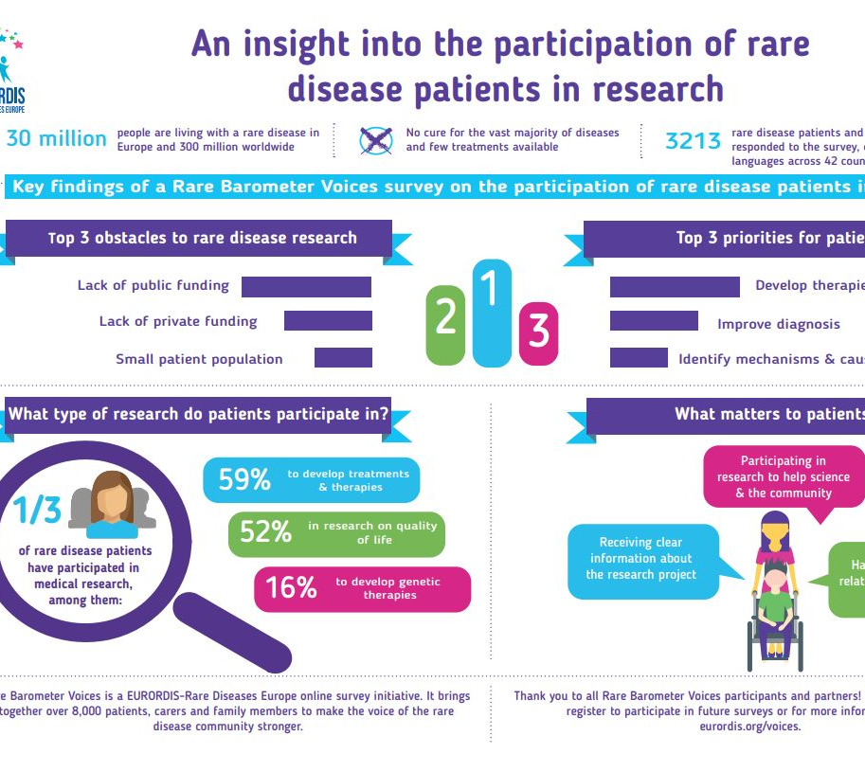
3. We might need to paraphrase a study explained in a text.

Slide 26
A concise paraphrase of a research article:
Using national survey data carried out by 3856 participants aged 25-60, Davis et al. (2015) tested the assertion that “an apple a day keeps the doctor away” and did not find statistically significant evidence in support of this hypothesis. While people who consumed apples were slightly less likely to use prescription medications, the study was unable to demonstrate a causal relationship between these variables.
Taken and adapted from www.scribbr.com

Slide 27
GO TO THE BREAKOUT ROOM!

Slide 28
Paraphrase the sentence:
“Working from home can lead to employees’ feeling isolated and dissatisfied” (King, 2009).
King indicates that workers can feel alone and discontented while working away from the office (2009).

Slide 29
Paraphrase the sentence:
2. “The increase in the number of students attending university has led to changes in the methods of lecture delivery” (Mendez, 2010).
Mendez claims that changes in teaching methods are the result of a rise in the number of university students (2010).

Slide 30
Paraphrase the sentence:
3. “Academic writing plays a very important role in university education as it is the medium in which students demonstrate their understanding of the subject” (Carter, 2001).
Carter highlights the importance of academic writing by stating that it is a part of university education where students’ subject comprehension can be measured (2001).

Slide 31
Read the text, highlight the main points, and borrow information by paraphrasing. Remember to cite!
Source: “Don’t Blame the Eater,” David Zinczenko, 2002
“Before 1994, diabetes in children was generally caused by a genetic disorder – only about 5 percent of childhood diabetes cases were obesity-related, or Type 2, diabetes. Today, according to the National Institutes of Health, Type 2 diabetes accounts for at least 30 percent of all new childhood cases of diabetes in this country. Not surprisingly, money spent to treat diabetes has skyrocketed, too. The Centers for Disease Control and Prevention estimate that diabetes accounted for $2.6 billion in health care costs in 1969. Today’s number is an unbelievable $100 billion a year.”
Sample paraphrase:
In the article “Don’t Blame the Eater,” Zinczenko (2002) compares the rates of Type-2 diabetes to those prior to 1994. He clarifies that instances of Type-2 diabetes have increased dramatically from 5 percent to 30 percent, as has the cost of treating this disease, reaching up to $100 billion a year from $2.6 billion in about thirty years.

Slide 32

SEE YOU NEXT WEEK!
STAY HEALTHY, STAY BALANCED…

